Slide 1


Verizon Case
Presentation
Prepared by:
Zeel Patel, Aida Sarinzhipova, Mingyu Chen, Kenny Wang, Kristina Shen, Chelsea Liu
November 2024

Slide 2

Agenda
1
Client Problem
2
Chosen Model and Rationale
3
Model Performance Assessment
4
Model Confusion Matrix
5
Business Value Estimate of the Model
6
In-Store App Interface
2

Slide 3

Client Problem
Problem Recap
Verizon Communications Inc. is one of the largest telecommunications companies in the United States, serving 120.9 million subscribers as of Q4 2020.
The company leads the market with a strong focus on mobile services, data plans, and devices.
Verizon Communications, Inc. faces financial risk by offering latest smart phones valued over $1,000 on contract, which effectively turns them into a lending institution. Identifying customers likely to default on these contracts is crucial for minimizing financial losses and supporting sustainable growth long-term.
Model & Impact
Ultimate Goal
Conducting an EDA will allow us to build a default prediction model, as well as estimate the dollar impact of the model for Verizon’s .
An application that can be used by Verizon staff within a store to approve or reject an application during live customer interactions.
3
Notes:
Business Context: Verizon Communications, Inc., one of the largest telecommunications companies in the U.S., generates much of its revenue by offering phone contracts to customers. However, by providing devices valued over $1,000 on contract, Verizon assumes considerable financial risk, effectively acting as a lending institution. The company seeks to implement a model that predicts the likelihood of customer default to optimize contract approvals and minimize losses.
Issue: Verizon’s current model for contract approvals has a default rate of 11.5% among approved applicants, leading to significant losses from unpaid contracts. The company’s challenge is to enhance decision-making in real-time, allowing store staff to approve or reject applications based on the likelihood of default. Inaccurate predictions can either result in loss from defaults or missed profit opportunities by incorrectly rejecting reliable customers.
Expected Outcome:
Predictive Modeling: Develop a classification model to assess default probability for each applicant, with the goal of reducing the default rate and minimizing false-positive rejections that would prevent reliable customers from joining Verizon.
Business Value Estimation: Provide a credible estimate of the dollar impact, expressed as a dollar change per million applicants, allowing Verizon to quantify the financial benefits of improved approval decisions.
Data-Driven Decision-Making: Enable store staff to make informed, real-time contract approval or rejection decisions, optimizing Verizon’s customer base, profitability, and overall operational efficiency.
Long-Term Profitability: Generate insights that support sustainable customer growth by reducing financial risk and retaining a higher proportion of reliable, paying customers.

Slide 4
Chosen Model – Random Forest
Rationale:
Provides key insights through feature importance - handles imbalance by maximizing precision and recall
Delivers high accuracy, prevents overfitting, and minimizes financial risk by identifying potential defaulters.
Random Forest Model Description:
a predictive tool that combines many small decision trees to make accurate classifications and predictions. It evaluates multiple decision paths to determine likely outcomes, providing a balanced and reliable prediction.
4
Notes:
Proposed Model:
We have selected random forest as the predictive model since it offers 90% accuracy and it shows strong ability to handle with large datasets with complex feature interactions.
Unique Advantages:
Random Forest provides valuable insights by ranking features based on their impact on predictions and highlighting key features related to customer characteristics including age, down payment, and monthly usage which closely related to the default risk.
It effectively balances between default and non-default cases by maximizing both precision and recall with precision of 70% in precision and 51% in recall which also helps make accurate default predictions as well as minimize false positives at the same time.
It presents high interpretability of results as it aligns well with the initial data analysis and adds credibility to the model’s relevance.
Rationale:
Random Forest provides reliable results due to its high accuracy which also allows stakeholders to better understand and make decisions.
It offers strong performance on unseen data and reduce the risk of overfitting led by high accuracy on train data.
It helps minimize financial risks of the company by effectively identifying potential defaulters which will successfully allows the company to take preventive measures to contribute to potential cost savings.
Proposed Model:
We have selected random forest as the predictive model since it offers 90% accuracy and it shows strong ability to handle with large datasets with complex feature interactions.
Unique Advantages:
Random Forest provides valuable insights by ranking features based on their impact on predictions and highlighting key features related to customer characteristics including age, down payment, and monthly usage which closely related to the default risk.
It effectively balances between default and non-default cases by maximizing both precision and recall with precision of 70% in precision and 51% in recall which also helps make accurate default predictions as well as minimize false positives at the same time.
It presents high interpretability of results as it aligns well with the initial data analysis and adds credibility to the model’s relevance.
Rationale:
Random Forest provides reliable results due to its high accuracy which also allows stakeholders to better understand and make decisions.
It offers strong performance on unseen data and reduce the risk of overfitting led by high accuracy on train data.
It helps minimize financial risks of the company by effectively identifying potential defaulters which will successfully allows the company to take preventive measures to contribute to potential cost savings.

Slide 5

Model Performance Assessment
Classification Breakdown:
Would be preferable to also minimize this – translates to lost revenues
True Positives (TP)
Correctly identified risky applicants who would default.
False Positives (FP)
Mistakenly rejected applicants who would have paid.
👎😌
👎 😔
Significant impact on business risk – need to be minimized as this translates to potential financial losses
False Negatives (FN)
Incorrectly approved applicants who defaulted.
True Negatives (TN)
Correctly approved reliable customers.
👍😈
👍 😇
Model Metrics Performance:
Recall of 51%
Measures how many of the actual defaulters were correctly identified
Accuracy of 91%
Measures the overall percentage of all correctly identified customers
Precision of 70%
Measures how many predicted defaulters actually default
5
Notes:
Classification Breakdown:
True Positives (TP): Correctly identified risky applicants who would default.
False Positives (FP): Mistakenly rejected applicants who would have paid.
True Negatives (TN): Correctly approved reliable customers.
False Negatives (FN): Incorrectly approved applicants who defaulted.
Classification Report Recap:
Precision for Class 1 (defaulters): Measures how many predicted defaulters actually defaulted. Precision =0.70
Recall for Class 1 (defaulters): Measures how many of the actual defaulters were correctly identified. Recall= 0.51
Accuracy: Measures the overall percentage of correctly classified customers. ​=0.90
Metric Analysis for Business Risk:
Given the definitions and business context, the key goal is to minimize the number of False Negatives (FN) — customers who are incorrectly classified as reliable and end up defaulting, which represents a high-risk scenario.
True Positives (TP) and False Negatives (FN) are particularly critical for understanding risky applicants.
False Negatives (FN) have a significant impact on business risk because these represent customers who are incorrectly approved and end up defaulting. This translates to potential financial losses and higher risk.
Which Metric is Most Important?
The most important metric in this scenario is recall for the defaulters (Class 1) because it directly relates to how well the model is capturing actual defaulters:
A higher recall for defaulters means fewer False Negatives (FN), i.e., fewer applicants who are incorrectly approved and later default.
Minimizing False Negatives is crucial to reducing financial risk, as every FN represents a loss to the business.
The current recall for class 1 is 0.51, meaning the model is only identifying around 51% of the actual defaulters. This indicates that 49% of the defaulters are being missed, which could lead to significant financial risk for the business.

Slide 6
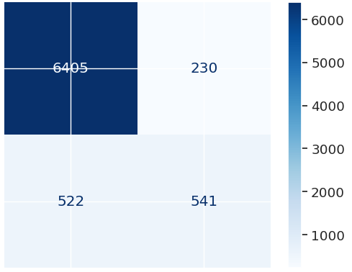
Model Confusion Matrix
Confusion Matrix of The Random Forest Model
Accuracy and Precision
👍 😇
👎 😔
x
Accurate
Precise
x
x
Accurate
Not Precise
Positive
x
x
x
x
x
True Label
👎😌
👍😈
x
Negative
Not Accurate
Precise
x
Not Accurate
Not Precise
x
x
x
x
x
Positive
Negative
x
Predicted Label
6
Notes:
Performance Overview:
The Random Forest model shows a high-level assessment while identifying customers who have a higher chance of defaulting in order to help manage financial risks effectively to sustain long-term growth in profitability.
Results Summary:
From the results, we can derive the following:
Confusion Matrix:
True Positives: The number of 6405 represents the number of customers who were correctly identified as non-defaulters. These customers are safely approved for contracts since they will make their payments which will not bring negative effects to the company.
True Negatives: The number of 541 represents the number of customers who were correctly identified as defaulters which allows the Verizon to avoid contracts with those customers to prevent financial risks more effectively.
False Positives: The number of 230 represents the number of customers who were mistakenly identified as defaulters which will probably lead to the potential risk of revenue loss since the company should have approved those customers for contracts to increase the overall profits. Therefore, it is significant to reduce false positives in order to help the company prevent financial losses and attract potential customers more effectively.
False Negatives: The number of 522 represents the number of customers who were mistakenly identified as non-defaulters which will increase the chance of financial risks due to unrecovered losses. Therefore, reducing false negatives is also significant to prevent the company from unpaid contracts.
Key Metrics:
Accuracy: The value of 90% of accuracy suggests that the model correctly predicts whether the customer will default in 90% of the cases which also indicates a high level of accuracy.
Prediction: The value of 70% in prediction suggests that the model correctly identifies a potential defaulter in 70% of the cases which is useful in making approval decisions for the company.
Recall: The value of 51% in recall suggests that the model captures 51% of true high-risk defaulters which suggests the needed further improvements for this model in order to increase the value of recall to reduce the financial losses.
Insights:
Overall , the model performs well in providing high accuracy and score in prediction while it still has the room of improvement due to the relatively lower value of recall. Since recall is generally important, we will continue optimizing the model to ensure that it is able to capture nearly all of the high-risk customers as expected.
In the future, we will focus on increasing the recall without reducing other high values to align the model better with the client’s objectives. The efforts will include potential outliers check and feature engineering such as encoding categorical variables.

Slide 7
$ Value Estimate of Our Model
Customer Classification | Customer Segmentation |  | Profit/Loss per Customer | Net Profit/ Loss
 | Our Model | Current Model |  | Our Model | Current Model
True Positives (TP) (Correctly classified defaulters) | 70,278 | 100,000 | $1,000 | $70,278,000 | $100,000,000
False Positives (FP) (Incorrectly classified as defaulters) | 29,878 | 100,000 | -$250 | -$7,469,500 | -$25,000,000
True Negatives (TN) (Correctly classified non-defaulters) | 832,034 | 708,000 | $250 | $208,008,500 | $177,000,000
False Negatives (FN) (Missed defaulters) | 67,810 | 92,000 | -$1,000 | -$67,810,000 | -$92,000,000
Totals | 1,000,000 | 1,000,000 |  | $203,007,000 | $160,000,000
👎😌
👎 😔
👍 😇
👍😈
Assumptions:
Customer Base: 1,000,000 applicants
Current Approval Rate: 80%
Current Default Rate: 11.5%
Hypothetical Default Rate: 50%
Loss per Default: $1000/customer
Profit per Paying Customer: $250
+ $43 million
7
Notes:
Below are our assumptions: Customer base: One million applicants for a phone contract (Verizon has many more applicants, but this will standardize your estimate as compared to other student groups.)
Current rejection rate: 80% of applicants are approved for a phone contract. Assume (counterfactually) that current approvals and rejections are uncorrelated with anything contained in the dataset, such as gender or credit score.
Current default rate of approved applicants: 11.5%
Hypothetical default rate of rejected applicants: Unknown, but important! Not likely to be more than 50%.
Loss per default: Direct average revenue loss of roughly $1000 per default. You might consider further indirect losses from servicing costs, administration, and the opportunity cost of being able to sell the same phone to a customer who pays and/or renews.
Profit per paying customer: Direct average profits of roughly $250 (time-discounted payments minus Verizon’s costs, including the phone itself), spread out over a 36- month contract. You might consider further indirect profits from the fact that the majority of customers will renew their contracts and purchase future phones.

Slide 8
Business Profits
+ 27%
+ 65%
8

Slide 9
Project Cost
This project is projected to yield a profit increase of $98,205,500 for Verizon. Our consulting fee of $1,275,000 represents approximately 1.3% of the added profit. This cost is reasonable given the complexity of the project and the end-to-end support our team will provide.
Additional Notes:
Return on Investment (ROI): Verizon can expect a high ROI due to the scale of profit increases.
Long-Term Value: With ongoing support, Verizon will be equipped to sustain and potentially increase these profits as the model adapts to new data over time.
Service Component | Cost
Project Management and Coordination | $150,000
Data Engineering and Preparation | $200,000
Model Development (Random Forest Classifier) | $300,000
Application Development (User Interface) | $250,000
Model Validation and Testing | $100,000
Deployment and Integration | $150,000
Training and Knowledge Transfer | $50,000
Ongoing Support and Monitoring (First Year) | $75,000
Total Cost | $1,275,000
9
Notes:
Cost Breakdown for Consulting Engagement
1. Project Management and Coordination
Description: Coordinating with Verizon’s stakeholders, managing timelines, weekly progress meetings, and project planning.
Estimated Cost: $150,000
2. Data Engineering and Preparation
Description: Data cleaning, preprocessing, and feature engineering to ensure high-quality data for the model.
Estimated Cost: $200,000
Justification: Data preparation is critical for effective model training and accuracy, impacting the realized profit significantly.
3. Model Development (Random Forest Classifier)
Description: Developing, training, and tuning the Random Forest Classifier model tailored to predict customer defaults accurately.
Estimated Cost: $300,000
Justification: The classifier drives the profit increase by effectively predicting which customers will default.
4. Application Development (User Interface)
Description: Developing a customer-facing application that includes an intuitive UI, integrates with the model, and enables store staff to make live decisions.
Estimated Cost: $250,000
Justification: The application facilitates easy model deployment and usage in stores, enabling Verizon to realize the profits generated by the classifier.
5. Model Validation and Testing
Description: Rigorous testing and validation to ensure model reliability, including sensitivity analysis and performance evaluation.
Estimated Cost: $100,000
Justification: Ensures model robustness and minimizes risks associated with false predictions, which can impact Verizon’s profits.
6. Deployment and Integration
Description: Deploying the model and application to Verizon’s existing systems, ensuring compatibility, scalability, and support for live usage.
Estimated Cost: $150,000
Justification: Integration with Verizon’s systems is essential for seamless operations and enables store staff to use the application effectively.
7. Training and Knowledge Transfer
Description: Training Verizon’s staff to use the application, interpret model outputs, and manage customer interactions based on predictions.
Estimated Cost: $50,000
Justification: Ensures Verizon’s staff can fully utilize the application, maximizing the realized profit from the model’s predictions.
8. Ongoing Support and Monitoring (First Year)
Description: Providing support and monitoring for the first year post-deployment, including model recalibration and application updates as needed.
Estimated Cost: $75,000
Justification: Helps Verizon adapt to any model or system adjustments, ensuring sustained performance and profit realization.

Slide 10
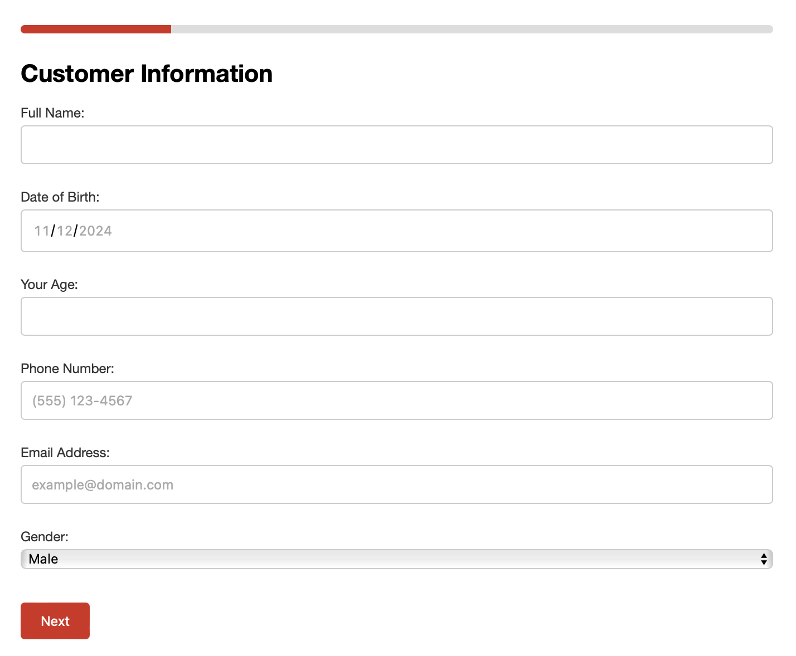
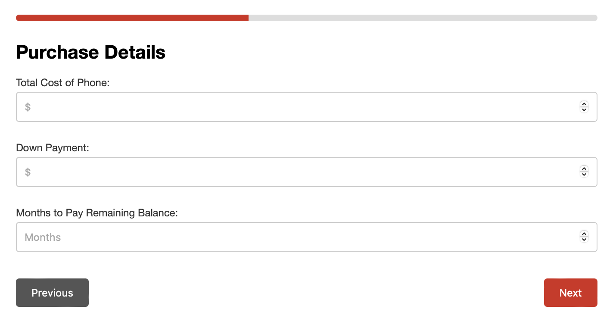
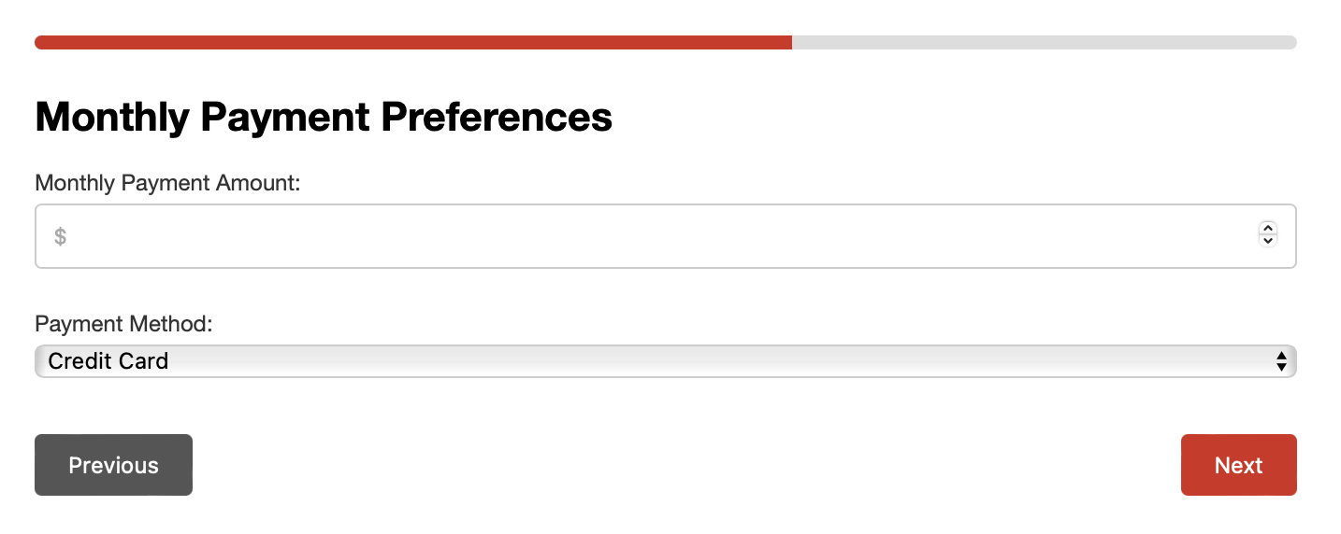

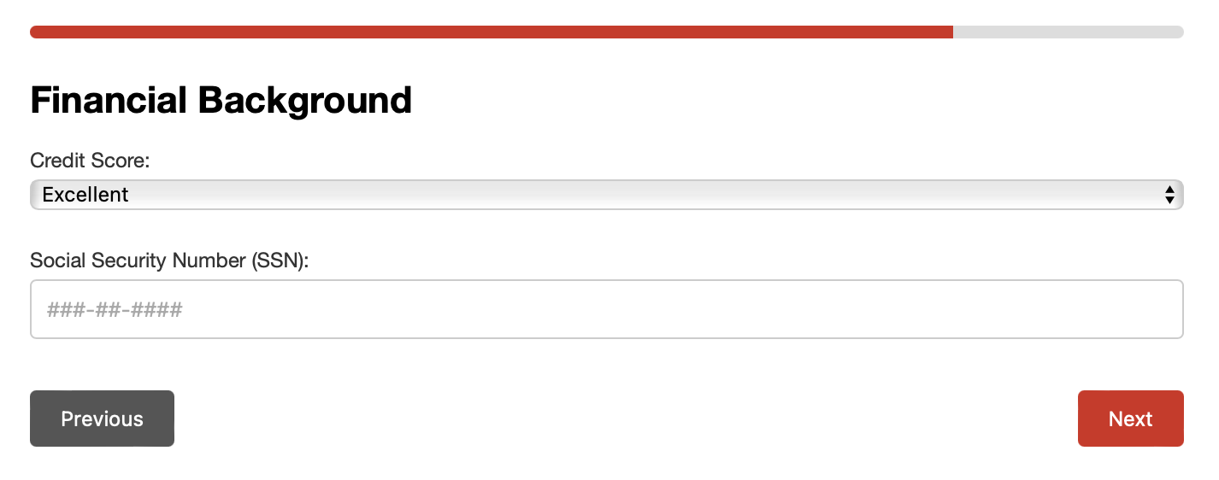
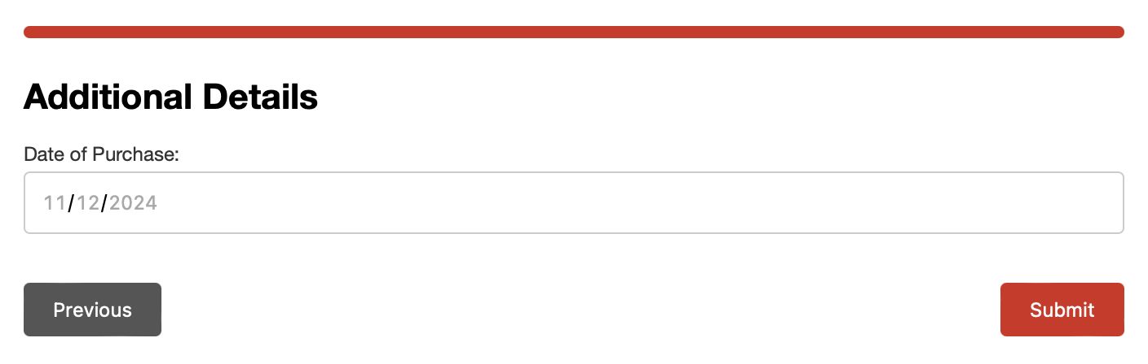
In-Store App Interface
Questions to ask customers during walk-ins at the Verizon stores for an instant approval/rejection
10

Slide 11

Thank you! Any Questions?
11

